Slide 1

PROFESSIONAL CERTIFICATE
IN MACHINE LEARNING AND
ARTIFICIAL INTELLIGENCE
Andres Garcia
Capstone Presentation
Feb 25, 2023

Slide 2
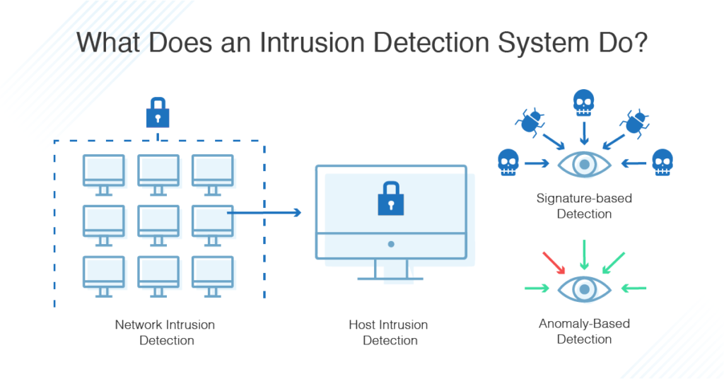
AGENDA
Capstone discussion on AI/ML Intrusion Detection System for Cybersecurity (IDS)
Intrusion Detection Systems (IDS) and Intrusion Prevention Systems (IPS)
Software Issues
Conclusion

Slide 3

INTRODUCTION – LEARNING FACILITATOR
Vice President for Data and Technology products – Analytics, AI ML at Dentsu International.
Served as analytics manager, consultant and professor at various organizations.
Usually roped in to initiate and execute analytics practices, programs and projects.
Authored a popular book on Project Management aligned to the University of Mumbai curriculum.
Contributing author to the Project Management Body of Knowledge Seventh Ed.
Contributing member of the Python Software Foundation
Logos belong to their respective owners

Slide 4
NETWORK
We’ll break into two groups.
Share your capstone project with each other and discuss possibilities in terms of value, approach and get / offer feedback.

Slide 5

INTERACTIVE UI WITH ML
Lets code!
https://colab.research.google.com/drive/1CQDs54KZwL8wkYqpxGFCpSUx_EFZuW0n#scrollTo=dtMH77oNvoHw

Slide 6

QUESTIONS?
Shoot!
Thank you for your involvement today.
And I wish you the very best that life has to offer.
See you next Monday.
This Photo by Unknown Author is licensed under CC BY-NC-ND

